Slide 1
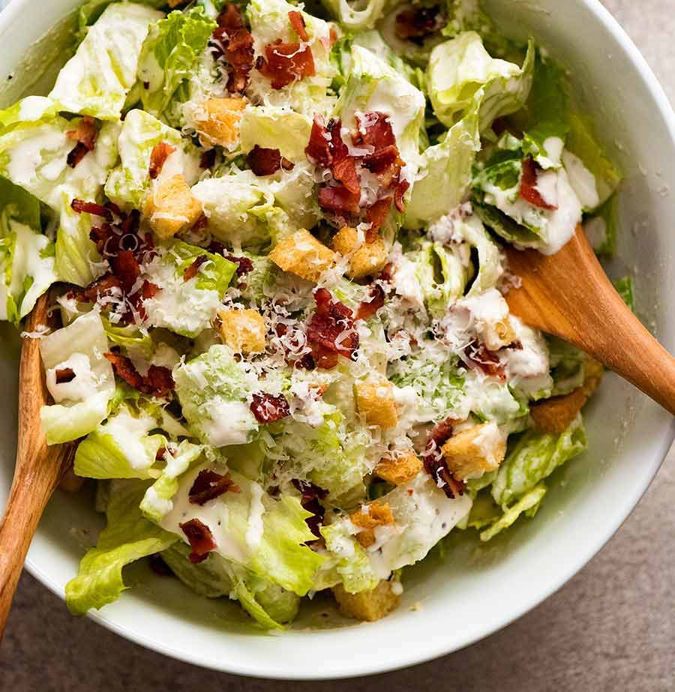
Caesar Salad
The salad was created by Caesar Cardini at Caesar's in Tijuana, Mexico, when the kitchen was overwhelmed and short on ingredients.
It was originally prepared tableside,' and it is still prepared tableside at the original venue.

Slide 2
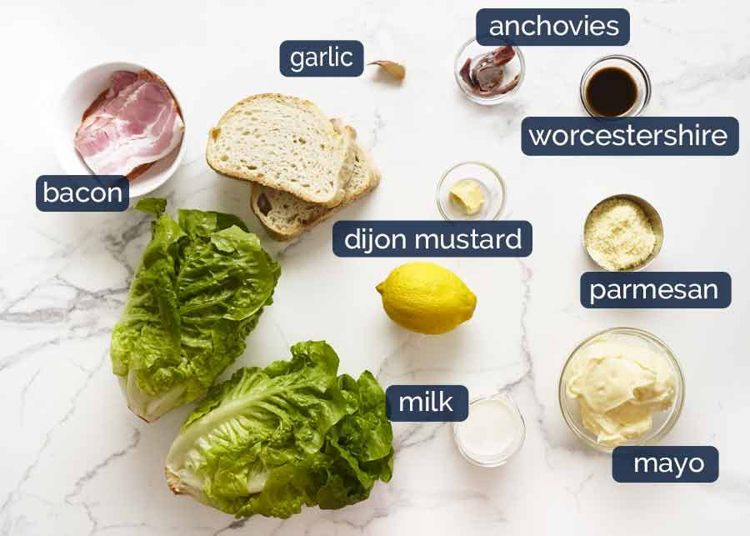
ingredients
2 tbsp olive oil
1 garlic clove (minced)
A pinch of salt
For the Dressing:
2 garlic cloves (minced)
2 tbsp mayonnaise
1 tsp Dijon mustard
1 tsp Worcestershire sauce
1 tbsp fresh lemon juice
1/4 cup extra-virgin olive oil
1/4 cup grated Parmesan cheese
Salt and black pepper to taste
For the Salad:
1 large head of Romaine lettuce (washed, dried, and chopped)
1 large chicken breast (cooked and sliced, optional)
Extra grated Parmesan cheese for topping

Slide 3
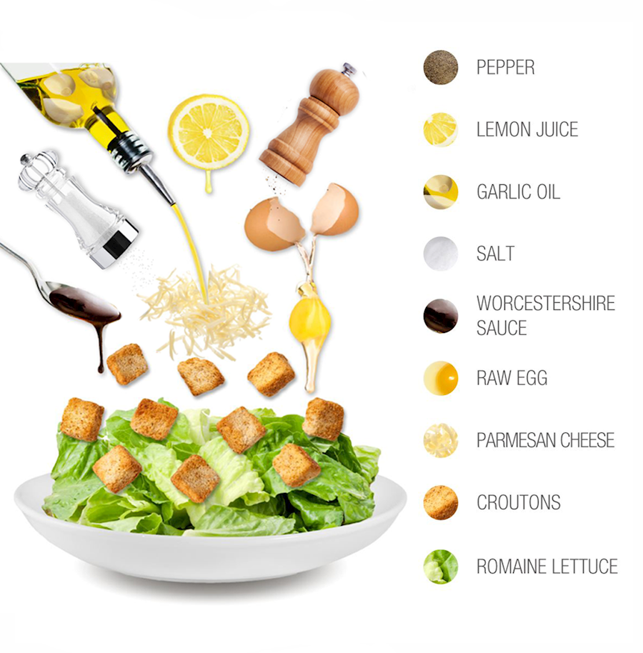
Preparing
Make the Croutons:
Preheat your oven to 200°C (400°F).
Toss the bread cubes with olive oil, minced garlic, and salt on a baking sheet.
Bake for 8–10 minutes until golden brown and crispy. Set aside to cool.
2. Prepare the Dressing:
In a medium bowl, whisk together the minced garlic, mayonnaise, Dijon mustard, Worcestershire sauce, and fresh lemon juice.
Slowly drizzle in the olive oil while whisking constantly until smooth and creamy.
Stir in the grated Parmesan cheese, then season with a pinch of salt and black pepper.
3. Assemble the Salad:
Place the chopped Romaine lettuce into a large mixing bowl.
Pour about half of the dressing over the lettuce and toss gently until the leaves are evenly coated. (Add more dressing if you prefer it richer).

Slide 4

Serve
Top the dressed lettuce with the homemade croutons, sliced chicken breast (if using), and an extra sprinkle of grated Parmesan cheese.

Slide 5
Enjoy your fresh and crunchy Caesar salad!

